Slide 1
Announcements
Assignment 2 will be ready tomorrow
  If you haven’t been able to get your Virtual machine and MySQL working, you should address this as soon as possible!
Quiz 3 is next week Tuesday at the end of class:
  SQL (October 11, 13)
  Virtualbox/Vagrant (October 13)
  Relational Calculus (October 18)
  EER diagrams (October 18)
  Today’s topic (more SQL) (October 20)
CS3319

Slide 2
Other Useful SQL Stuff!
Topic 9
READINGS:
Chapter 7 – More SQL: Triggers
Chapter 30 – Database Security
TOPICS:
System Tables
Database Security
Triggers and Stored Procedures
CS319

Slide 3
System Tables
QUESTION: What do you do if you create a Table and can’t remember what type a particular column is?
QUESTION: What are some of the things (components) in a relational database:
QUESTION: What is another word for a thing in an ER diagram?
CS319
Notes:
Show tables;
Databases,Tables, columns, datatypes, views
Entity

Slide 4
QUESTION: How do you think MySql represents your database?
MySQL represents your database as a bunch of tables, just like you represent your database!
These tables are called System Tables or System Catalog or Data Dictionary or Metadata or a mini database which describes your database.
System Catalog keeps track of all the table names, attribute names, attribute domains, descriptions of constraints, etc...
The Systems tables are hidden from you slightly but you can see them if you really want to ☺
CS319

Slide 5
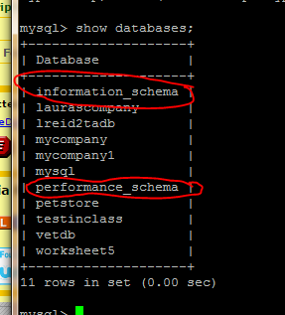
Viewing the MySql System Catalog
Notice the 2 databases circled.
You did NOT create those
They can be very useful, as you will see.
You can only read from these, you can NOT do any inserts, updates or delete operations
Need the use command →
use information_schema;
http://dev.mysql.com/doc/refman/5.7/en/information-schema.html
CS3319

Slide 6
Try these SQL commands in MySQL on your Virtual Machine:
show databases;
OR
select SCHEMA_NAME from information_schema.SCHEMATA;
OR
use information_schema;
select SCHEMA_NAME from SCHEMATA;
select * from SCHEMATA;
CS33s9

Slide 7
QUESTION: so what does the SCHEMATA table hold?
QUESTION: What is the SCHEMA_NAME?
CS3319

Slide 8
Now try this…
show tables;
OR
select TABLE_NAME from information_schema.TABLES
OR
use information_schema;
select TABLE_NAME from TABLES;
select * from TABLES; (watch what happens with this command)
CS3319

Slide 9
Question: how would you only show the table names in a particular database?
To figure this out, do this command first:
select * from information_schema.TABLES;
Then consider how you would modify this command to show just the tables in the petoffice database?
select TABLE_NAME from information_schema.TABLES
CS3319
Notes:
select TABLE_NAME from information_schema.TABLES where TABLE_SCHEMA = ‘petoffice’;

Slide 10
Type of information you can get from the System Catalog:
| PARTITIONS |
| PLUGINS |
| PROCESSLIST |
| PROFILING |
| REFERENTIAL_CONSTRAINTS |
| ROUTINES |
| SCHEMATA |
| SCHEMA_PRIVILEGES |
| SESSION_STATUS |
| SESSION_VARIABLES |
| STATISTICS |
| TABLES |
| TABLESPACES |
| TABLE_CONSTRAINTS |
| TABLE_PRIVILEGES |
| TRIGGERS |
| USER_PRIVILEGES |
| VIEWS |
| INNODB_BUFFER_PAGE |
| INNODB_TRX |
| INNODB_BUFFER_POOL_STATS |
| INNODB_LOCK_WAITS |
| INNODB_CMPMEM |
| INNODB_CMP |
| INNODB_LOCKS |
| INNODB_CMPMEM_RESET |
| INNODB_CMP_RESET |
| INNODB_BUFFER_PAGE_LRU |
+---------------------------------------+
This command:
select TABLE_NAME from information_schema.TABLES where TABLE_SCHEMA = 'information_schema';
returns this:
+---------------------------------------+
| TABLE_NAME |
+---------------------------------------+
| CHARACTER_SETS |
| COLLATIONS |
| COLLATION_CHARACTER_SET_APPLICABILITY |
| COLUMNS |
| COLUMN_PRIVILEGES |
| ENGINES |
| EVENTS |
| FILES |
| GLOBAL_STATUS |
| GLOBAL_VARIABLES |
| KEY_COLUMN_USAGE |
| PARAMETERS |
CS3319

Slide 11
More info…
Question: Consider this command:
select * from information_schema.REFERENTIAL_CONSTRAINTS where CONSTRAINT_SCHEMA="vetdb";
What do you think it will do?
Sample Output:
CS3319

Slide 12
All the system catalog views are created when a database is created with the CREATE DATABASE command
The catalog views and tables CANNOT be explicitly dropped or created
The catalog views and tables are updated as you perform SQL commands.
CS319

Slide 13
Question: Which of the following 2 commands do you think will update the catalog tables/view?
  INSERT into Pets VALUES (“dog”,”Scruffy”,22);
  ALTER TABLE Pets ADD COLUMN weight INT;
How could we check?
select * from information_schema.COLUMNS where TABLE_NAME=“Pets”;
CS319

Slide 14
Why are System/Catalog tables useful?
What if you want to see which tables are really big (more than a given number of rows?)
SELECT CONCAT(table_schema, '.‘ ,table_name) as table_name, table_rows FROM information_schema.tables WHERE table_rows > 1000 AND table_schema not in('information_schema','mysql','performance_schema') ORDER BY table_rows desc;
+----------------------------------+------------+
| table_name | table_rows |
+----------------------------------+------------+
| customers.orders | 2007 |
| customers.contact_info | 1245 |
| customers.rewards_points | 2147 |
| business_contacts.company_info | 1340 |
| business_contacts.phone_numbers | 1712 |
| sonar.project_measures | 178618 |
| sonar.resource_index | 110328 |
| sonar.rule_failures | 40793 |
+----------------------------------+------------+
CS3319

Slide 15
Maybe you want to see which queries take a
long time to run:
(Which queries are taking more than 10 minutes)
SELECT * FROM information_schema.processlist WHERE
COMMAND = 'Query' AND time > 60 * 10;
+---+--------+----------------+------+---------+------+-------+------------------+
| Id| User |Host | db | Command | Time | State | Info |
+---+--------+----------------+------+---------+------+-------+------------------+
| 1 | root | localhost:1715 | | Sleep | 73 | | |
| 2 | root | localhost:1716 | test | Query | 0 | | show processlist |
| 5 | sonar | localhost:1835 | test | Sleep | 2359 | | |
+---+--------+----------------+------+---------+------+-------+------------------+
CS3319

Slide 16
Security and Access
CS3319

Slide 17
Database Security
Legal/Ethical Issues (right to privacy of information, ...)
Policy Issues (what does your company make available; who within the company should be updating what)
System Issues (where and how should security be handled? Physical hardware level, operating system level, DBMS level) →we will look at this
CS319

Slide 18
2 Types of Database Security Mechanisms:
  Discretionary: grant privileges to users on tables, records, fields, etc. based on the discretion of the owner of the table (what you’re used to in unix)
  Mandatory: Multiple security levels, categorize the data and the users on the levels; decisions of who gets to see what are based only on relative levels/security labels (example: Top Secret, Secret, Confidential, Unclassified)
CS319

Slide 19
Database Security and the DBA
DBA has a system account (like a superuser). The DBA account performs the following actions
  Account Creation (sets account name, password)
  Privilege Granting
  Privilege Revocation
  Security Level Assignments (set user account to appropriate security classification)
  QUESTION: what is the superuser called in MySQL?
User must log on to DBMS using an account name and password
All actions by the user are monitored in a log file
If anything suspicious occurs a database audit is performed to check actions and accounts
CS319

Slide 20
Discretionary Access Control
Grant and revoke privileges from users, 2 levels
  Account Level: giving the user access to the
  database in general
    CREATE SCHEMA
    CREATE TABLE
    CREATE VIEW
    ALTER, DELETE, MODIFY, SELECT
CS319

Slide 21
Relation Level: giving the user access to each relation in the database
    Each relation R is assigned an owner account (usually the account that created the relation in the first place). The owner account is given all privileges on that relation. This owner can pass on privileges to other users by granting privileges to their accounts
    SELECT privilege on R → Account can only retrieve from R
    MODIFY privilege on R (divided into Update, Delete, Insert privileges). With the Insert and Update you can restrict to just certain attributes
    References privilege on R → Used for creating integrity constraints
CS319

Slide 22
Can also create VIEWS → if you want a user to only see column A from table AAA and column B from table BBB you can create a view and give the user access to the view
CS319

Slide 23
Creating Users
    MySQL Example:
    http://dev.mysql.com/doc/refman/5.7/en/create-user.html
CREATE USER ‘wbeldma’@’localhost’ identified by ‘mypass’;
OR (for a user with no password)
CREATE USER 'jeffrey'@'localhost';
OR
CREATE USER 'jeffrey'@'localhost' IDENTIFIED BY PASSWORD ‘*90E462C37378CED12064BB3388827D2BA3A9B689';
(Versions prior to MySQL 5.7 could log passwords in the log file. See the documentation.)
CS319

Slide 24
DB Privileges SQL Commands
REVOKE → removes privileges
GRANT → adds privileges
WITH GRANT OPTION → allows one user to give another user the ability to give other users privileges
CS319

Slide 25
Question: Can you figure out what these commands might do?
GRANT ALL ON mydb.* TO 'someuser'@'somehost';
GRANT SELECT, INSERT ON mydb.* TO 'someuser'@'somehost';
GRANT SELECT, INSERT ON mydb.mytbl TO 'someuser'@'somehost';
GRANT SELECT (col1), INSERT (col1,col2) ON mydb.mytbl TO 'someuser'@'somehost';
CS3319

Slide 26
EXAMPLES:
Assume that:
  EMPLOYEE, PROJECT are tables
  wbeldma, sskinner, nflanders, hsimpson, mburns are users
  BIRTHDATE, SALARY and NAME are some of the columns from the table EMPLOYEE
CS319

Slide 27
Suppose that nflanders does the following:
GRANT SELECT on EMPLOYEE to ‘hsimpson’@’localhost’ with GRANT OPTION;
Suppose then that hsimpson does this command
GRANT SELECT on EMPLOYEE to ‘mburns’@’localhost’;
QUESTION: What do you think happens when this command is executed:
REVOKE SELECT on EMPLOYEE from ‘hsimpson’@’localhost’?
CS319

Slide 28
Suppose we only want sskinner to see the birthdate and name of employees but not salaries or other info for the Payroll department (then we would do the following:)
CREATE VIEW LimitEmp as SELECT Name, BDate FROM EMPLOYEE WHERE DeptNo = “5”;
QUESTION: Then what would we do?
QUESTION: What do you think this statement does:
GRANT UPDATE (Salary) ON Employee TO bgumbel
CS319

Slide 29
Example from the System Tables:
mysql> select * from USER_PRIVILEGES;
+-------------------+---------------+----------------+--------------+
| GRANTEE | TABLE_CATALOG | PRIVILEGE_TYPE | IS_GRANTABLE |
+-------------------+---------------+----------------+--------------+
| 'root'@'localhost‘| def | SELECT | YES |
| 'root'@'localhost‘| def | INSERT | YES |
| 'root'@'localhost‘| def | UPDATE | YES |
| 'root'@'localhost’| def | DELETE | YES |
| 'root'@'localhost’| def | CREATE | YES |
…
mysql> select * from TABLE_PRIVILEGES;
+----------------+---------------+--------------+------------+----------------+--------------+
| GRANTEE | TABLE_CATALOG | TABLE_SCHEMA | TABLE_NAME | PRIVILEGE_TYPE | IS_GRANTABLE |
+----------------+---------------+--------------+------------+----------------+--------------+
| ''@'localhost' | def | vetdb | owner | SELECT | NO |
| ''@'localhost' | def | vetdb | owner | INSERT | NO |
| ''@'localhost' | def | vetdb | owner | UPDATE | NO |
| ''@'localhost' | def | vetdb | owner | DELETE | NO |
| ''@'localhost' | def | vetdb | owner | CREATE | NO |
| ''@'localhost' | def | vetdb | owner | DROP | NO |
| ''@'localhost' | def | vetdb | owner | REFERENCES | NO |
….
CS319

Slide 30
Role-Based Access Control
A new idea for designing access control for complex systems:
Define a number of roles, where each role is a set of privileges/permissions like {(insert, TableA), (delete, TableB)}
Grant roles to users. This saves a lot of time over granting of individual permissions.
It really becomes important when an employee leaves the company or changes jobs. Just remove some roles from their profile – you don’t have to figure out which 50-100 privileges to revoke to represent what they should no longer be allowed to do.
Oracle, SQL Server, and Sybase have roles.
MySQL 8.0 (beta) has roles
CS319

Slide 31
Mandatory Access Control
Typical Security Classes:
  Top Secret (TS) - highest
  Secret (S)
  Confidential (C)
  Unclassified (U) - lowest
TS > S > C > U
QUESTION: Who typically uses this system?
CS319

Slide 32
Bell-LaPadula model classifies:
  Subjects (Users, Accounts, Programs), called the clearance, refered to as CLASS(S)
  Objects (Relations, Tuples, Columns, Views, Operations), called the classification, refered to as CLASS(O)
2 Rules are:
  A subject S cannot read from an object O unless class(S) >= class(O)
  A subject S cannot write to an object O unless class(S) <= class(O)
QUESTION: Rule 1 makes sense, however rule 2 is not quite as obvious, why is this rule enforced?
CS319

Slide 33
Statistical Database Security
Often stats will be run on a database to find out data about customers, employees, etc…
For example:
    Find the average salary & age of customers who live in Ontario.
The user running these stats must have access to the data, however we might not want them to see the actual data per record, just run stats on the data (to keep the information private)
CS319

Slide 34
Statistical users have access to certain functions like COUNT, MAX, MIN, AVERAGE, and STANDARD DEVIATION but not the individual data, called statistical queries
  Thus, we can do this:
  Select count(*) from EMPLOYEE where sex=‘F’
  BUT NOT THIS:
  Select * from EMPLOYEE where sex = ‘F’
HOWEVER in some cases it is possible to deduce the values of an individuals records as follows:
CS319

Slide 35
Example: We want to know Dr. Sylvia Osborn’s salary but we shouldn’t be allowed to find that out. Suppose we know that she is the only tenured Prof. in the computer science department who is female. We create a query as follows:
Select Count(*) as Result from Faculty where Dept='Computer Science' and Position='Tenured' and Sex = 'F'
and we get the following answer from DB2:
RESULT
1
QUESTION: Now we know only 1 such Prof. exists, so what query do we write now:
CS319

Slide 36
Strategies for handling such leaks of information:
Question: Do you have any ideas/suggestions for how you could handle such leaks of information?
Limit queries if the result returns a value less than a certain threshold
Limit repeated queries that refer to the same tuples
Introduce "noise" (inaccuracies) into results to make it difficult to deduce individual information
CS319

Slide 37
Tools for Designing Access Control for a Typical Commercial Database Application:
Use VIEWS to narrow down exactly what a user needs
Use roles if your db package has them. If not, design the roles off-line (the way you would use ER diagrams), and make sure you implement the roles with the other aspects of the application
Most systems have ways of making applications/packages with specific interfaces. E.g. you would design the buttons on a bank machine interface for only those operations a casual user is allowed to do.
CS319

Slide 38
Triggers and Stored Procedures
CS3319

Slide 39
Triggers and Stored Procedures
Triggers are a set of SQL statements that execute when a certain event occurs in a table
Similar to a constraint but more powerful:
  Example: a constraint will disallow a salary to go above a certain amount
  A trigger can check how much the salary changes and if the change is above a certain amount, it can cause a user-defined function to notify an administrator about the change.
Almost all database management systems have triggers, we will be looking at the structure of MySQL triggers.
CS319

Slide 40
Sample MySQL Trigger
9
delimiter //
CREATE TRIGGER upd_check BEFORE UPDATE ON account
FOR EACH ROW
BEGIN
IF NEW.amount < 0 THEN
SET NEW.amount = 0;
ELSEIF NEW.amount > 100 THEN
SET NEW.amount = 100;
END IF;
END;//
delimiter ;
1
2
3
4
6
8
7
5
 | Parts of the trigger
1 | Trigger Name (upd_check)
2 | Trigger activation time (BEFORE)
3 | Triggering event (UPDATE)
4 | Triggering table name (account)
5 | Attribute in table (NEW.amount)
6 | Granularity (FOR EACH ROW)
7 | Trigger condition (IF NEW.amount < 0 THEN)
8 | Trigger body (BEGIN … END;)
9 | In MySQL need to change the delimiter temporarily.
9
CS319

Slide 41
QUESTION: What will cause the trigger to be activated?
When you no longer need the trigger, do the following command:
DROP TRIGGER [IF EXISTS] trigger_name
QUESTION: What do you think happens if have a table called account and it has a trigger associated with it and you do the command:
DROP TABLE account?
CS319

Slide 42
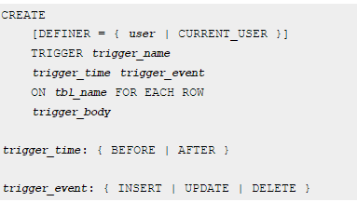
Parts of the trigger in more detail:
NOTES:
you can not have multiple triggers for a given table that have the same trigger event and action time, e.g. you can’t have 2 BEFORE INSERT triggers BUT you can have a BEFORE and AFTER trigger or a BEFORE INSERT and BEFORE UPDATE triggers
CS319

Slide 43
Granularity:
  FOR EACH ROW: the trigger is activated every time a row is changed
Trigger Condition:
  similar to the where clause in an SQL statement.
  If you do not have a trigger condition, the trigger’s body executes every time the trigger is activated.
CS319

Slide 44
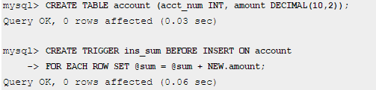
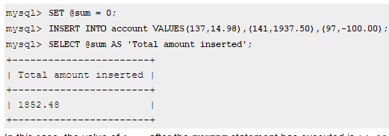
Another Example:
CS319

Slide 45
Another Example:
CREATE TABLE test1(a1 INT);
CREATE TABLE test2(a2 INT);
CREATE TABLE test3(a3 INT NOT NULL AUTO_INCREMENT PRIMARY KEY);
CREATE TABLE test4(
a4 INT NOT NULL AUTO_INCREMENT PRIMARY KEY,
b4 INT DEFAULT 0
);
delimiter |
CREATE TRIGGER testref BEFORE INSERT ON test1
FOR EACH ROW
BEGIN
INSERT INTO test2 SET a2 = NEW.a1;
DELETE FROM test3 WHERE a3 = NEW.a1;
UPDATE test4 SET b4 = b4 + 1 WHERE a4 = NEW.a1;
END;
|
delimiter ;
INSERT INTO test3 (a3) VALUES (NULL), (NULL), (NULL), (NULL), (NULL), (NULL), (NULL), (NULL), (NULL), (NULL);
INSERT INTO test4 (a4) VALUES (0), (0), (0), (0), (0), (0), (0), (0), (0), (0);
INSERT INTO test1 VALUES (1), (3), (1), (7), (1), (8), (4), (4);
SELECT * from test1;
SELECT * from test2;
SELECT * from test3;
SELECT * from test4;
CS319

Slide 46
Another Example Continued:
Now try this out in your virtual machine
CS319

Slide 47
QUESTION: Assume we have the tables:
STUDENT(Student_Num, LastName, …Age)
UNIV_STATS(Num_of_Students, Total_Age, Average_Age, …)
Write a trigger that will keep the UNIV_STATS table accurate:
CS319

Slide 48
Stored Procedures
A precompiled application program, written in any language such as C, C++, COBOL, Java, … that is executed in response to a SINGLE SQL CALL statement
May contain SQL statements as well as other logic statements
Useful mainly in CLIENT/SERVER applications
CS319

Slide 49
QUESTION: Suppose you need to update the salary of all 100,000 employees in your database, by 6.25%. You are working in Sydney, Australia with a java application on your desktop, the database is in New York City. What problems can you foresee?
QUESTION: What do you do to solve this problem?
ANSWER: Use a Stored Procedure!
CS319

Slide 50
Advantages of Stored Procedures
In a client/server environment, when each SQL statement is issued, it goes to get the data from the database on the server and returns back the results to the client, for the client to work with, thus there is lots of network transmission time and lots of contention for locks (we will talk more about locks later)
If instead we put all our SQL statements and commands in a program that is PRECOMPILED on the server and just execute that program, we don’t tie up the network or have to hold lots of locks. Also pre-compile program run VERY quickly.
Not much of an advantage when you don’t have a client/server environment, but stored procedures still might be helpful in case your company ever plans to go to that sort of environment!
CS319

Slide 51
Pros and Cons taken from here
Pros
  Share logic with other applications.
  Isolate users from data tables. Ability to grant access to the stored procedures that manipulate the data but not directly to the tables.
  Provide a security mechanism. Considering the prior item, if you can only access the data using the stored procedures defined, no one else can execute a DELETE SQL statement and erase your data.
  To improve performance because it reduces network traffic. With a stored procedure, multiple calls can be melded into one.
CS3319

Slide 52
Pros and Cons continued…
Cons
  Increased load on the database server
  learning curve. You'll need to learn the syntax of MySQL statements in order to write stored procedures.
  You are repeating the logic of your application in two different places: your server code and the stored procedures code, making things a bit more difficult to maintain.
  Migrating to a different database management system (DB2, SQL Server, etc) may potentially be more difficult.
CS3319

Slide 53
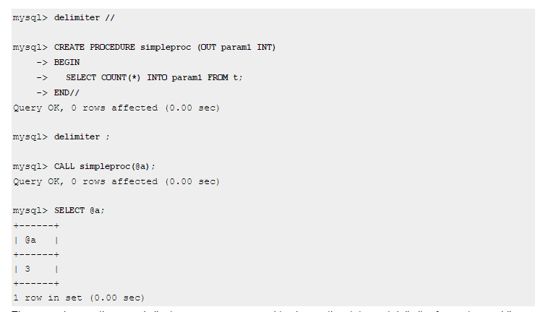
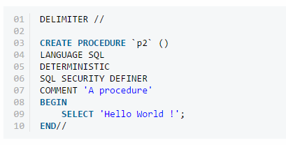
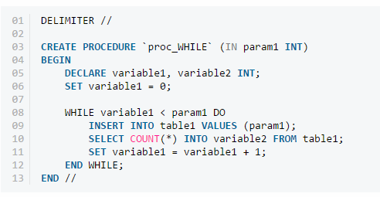
Examples from MySQL
CS3319

